Slide 1
Corporate Information Security
Host Security

Slide 2
Lecture introduction
The focus of this lecture is to look at information security from single system point of view
  Integrity
  Availability
  Authentication
  Management
  Monitoring
  Recovery

Slide 3
Threats From Outside The Box
Attacks on open services on the system
Attacks on open shares or with known password
Attacks on files downloaded by this system
Attacks coming from server to some client (IE,Firefox)
Attacks on plugin modules (Flash, Java)
Attacker gets physical access to computer
Power spikes, fire, water and other environmental threats

Slide 4
Threats From Inside The Box
User deletes system or application files
User deletes or overwrites his own files
User executes malware
User installs file sharing software and sharing all files
User installs software that is spyware
Attacker exploits some hole in system application to gain elevated user privileges (root or administrator)
File system filling up so that no new files can be added
File system corrupts or some other OS component fails
Hardware breaks down

Slide 5
Systems, Users and Accounts
User identity in OS is called user account
  Account permissions determine what user can access
  Each file is owned by some user, and has access flags that determine who can access it
  Basically account limits user so that he cannot damage system or other users (if configured right)
In addition to normal user there is the superuser
  Root in Unix, Administrator in Windows
  Superuser can do what ever he wishes

Slide 6
Anatomy Of System Hack
At this point we assume that attacker knows target
  Has done his homework
  Is someone from inside the company
Stages of attack on a host
  Get into the system
  Get super user privileges
  Do the damage
  Erase traces

Slide 7
Typical Malware Infection
Infections mostly start with client exploit
User either visits hostile site, or get's exploit over mail
The initial exploit drops payload to system
Payload connects to C&C and downloads additional
payload components
  Components hide as well as possible
  One of components is registered as autostart
  The rest forms the monetizing payload

Slide 8
Elevate Privileges To Superuser
On most systems actions of normal users are limited
  So the attacker wants to become superuser (root)
Ways to get superuser privileges
  Guess superuser password
  Get access to password file and break it
  Exploit local vulnerability to get superuser account
    Many applications are owned by root but executable by user
    Vulnerability in such application can give attacker superuser privileges

Slide 9
Hiding In The System
Most efficient way to hide is to use rootkit
But this requires root access and fresh rootkit
Thus hiding among system files is commonly used trick
For example who would notice an extra svchoster.exe
Or any other system sounding name in System32 dir?
Clean windows install has almost 50K of executable files, thus hiding among them is easy
However also hiding among system files requires a root access

Slide 10
Is Root Really Needed?
Modern OS are good at preventing unauthorized root
Thus attackers are finding alternative solutions
Most modern malware do their deeds with user rights
  Install to %appdata%
  Modify browser instead of system settings
  Use only user level launch points in registry
Similar operations are also possible on other OS
  Otherwise users would be really frustrated on having to constantly type password

Slide 11
Get The Loot
Now the attacker is the local superuser so he can:
  Install key logger to catch other user passwords
    Very dangerous if network admin logs in to the host
  Get the password file and crack it
    Windows maintains a local cache of authorizations
    So if domain admin has logged in...
  Steal, modify or delete files
  Add the host as part of a botnet
  Use as stepping stone for further attack into the company systems

Slide 12
Erase Traces
Remove own actions from the log files
  Locate logs in the system and modify them
  Clear file access history
  Clear shell history
Disable/corrupt intrusion detection systems
Disable corrupt firewall and Anti-Virus
Leave traps that trash the system if someone starts investigating the system
Find out did the alert already go to system administrator

Slide 13
Typical Server Infection
Almost all attacks are workstation based, almost
Which means that vulnerable servers will be still hit
Most typical attacks are over web application
Which either grants attacker just DB access or remote shell/code execution attack
If it's DB based he will be limited on whats in the DB
With remote shell the attack will continue just as it would be continue in workstation

Slide 14
Attacks Into Cloud Based Systems
Cloud based systems are not that different from server
A typical cloud implementation is just a virtual Linux
  Thus attacker can compromise it just like any other
However sometimes the cloud provider gets owned
Which means that any of the hosted services can be attacked

Slide 15
Things That Attacker Needs
Contact to the victim
User client to load the content that contains exploit code
Or service that is running and visible to network
Vulnerability that it can exploit to get code running
Write access to system in order to create files
File execution capabilities to place where it wrote files
Capability to start automatically on boot
Communication channel for command and control

Slide 16
How To Protect System From Hacking?
Install secure system
  Configure system so that it is resistant to attacks
  Pay attention to things that make monitoring easier
Maintain the system
  When new vulnerabilities are found, fix them
  Make sure that updates do now weaken security
Defend the system
  Monitor the system so that attacks are detected
  When attack succeeds, limit the damage and recover system

Slide 17
Secure Installation Of A System
System is at it's most vulnerable when it is being installed
  All security holes are still unpatched
  No security measures are in place
  If system is hacked when it still being installed, it is almost impossible to detect afterward
Thus it is very important to install system in secure manner so that it can be relied upon
  System should already be secured before anyone has access to it

Slide 18
Choosing The Hardware
Know the environment
  Protected office, public access, protected server room
Know the purpose of the system
  Replaceable workstation vs durable server
Make sure that the hardware is resilient
  Dual power supplies
  RAID systems
  UPS or at least power spike filtering
  Does the computer need protection from physical tampering?

Slide 19
Can You Really Trust That Hardware
NSA ANT unit specializes in tampering hardware
  Low level system or hardware backdoors and bugs
Device can be compromised before you get it
Some tampering can be erased by reinstalling and reflashing BIOS. But others cannot be removed
Thus for critical equipment, don't get anything with long delivery times. And if possible go a pick it from supplier
http://leaksource.wordpress.com/2013/12/30/nsas-ant-division-catalog-of-exploits-for-nearly-every-major-software-hardware-firmware/

Slide 20
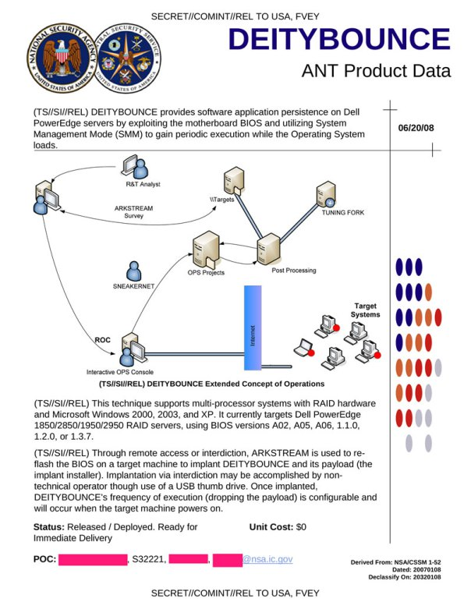

Slide 21
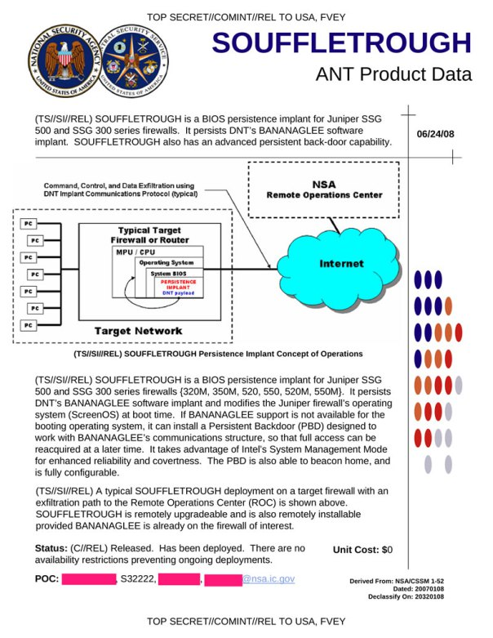
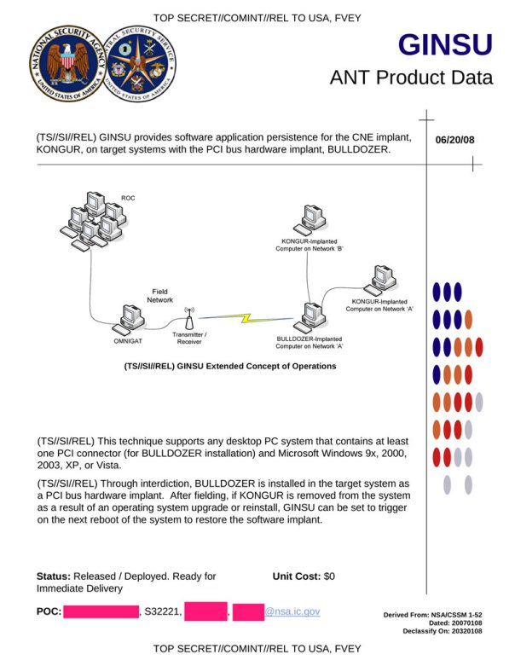

Slide 22
Choosing The Operating System
Get the right OS for task
  What do applications require?
  Do you need standard system for 1000+ PCs?
  What is the security history of the OS?
  How fast the OS vendor provides updates?
  How easy the OS is to keep up to date?
Each OS has its benefits and downsides
  PC platform operating systems use cheap hardware
  HP-UX and Solaris run on more reliable hardware

Slide 23
Different Flavors Of Operating Systems
Common mainstream OS (Windows,Linux)
  Easy to administrate, skilled people are available
  Well understood by hackers, security news spread fast
Heavy duty server OS (Solaris, HP-UX)
  Required people skilled in particular operating systems
  Less known for hackers, less holes, more time to react
Security minded operating systems (OpenBSD,Qubes)
  Written in security conscious manner
  Difficult to administrate, but has very few holes

Slide 24
File Systems
Correct partitioning makes life easier
  Estimate what space does each partition need
  Which partitions fill up with time?
Choose the right file system for the partition
  Does the partition need speed, or recovery
  Is there any critical data there, better encrypt it
RAID protects you from broken drives
  But does not replace backups
  Power spike, broken HDD controller, stolen server

Slide 25
Hard Disk Encryption
Hard-disk encryption encrypts files transparently
  Users and applications wont even notice. Encrypted disk/partition/directory is used as before
  Some tools encrypt whole partitions, some encrypt directories
  A password or some other authentication is required at boot
  Encryption prevents anyone reading the data without key
Hard-disk encryption tools have their limits
  No protection from file access when system is running
  Encryption decreases disk performance and loads CPU
  Recovery after hard-drive failure is usually impossible

Slide 26
Uses For Hard Disk Encryption
Laptops are other computers that travel outside office
  Protects company secrets when a computer is stolen
  Even best security can be cracked with physical access. But encryption is whole other deal
Computers that contain critical data
  Encrypt the whole hard drive, so that if someone gets access to hard drive the data is unreadable
  It may be a good idea to encrypt disks on all systems

Slide 27
Physical Access Control
With physical access attacker can defeat any access control
  There are CD's that change admin PW in seconds..
Protecting from someone who gets physical access is rather difficult, but there are some things you can do
  Install boot up password on BIOS
  Install hard disk encryption that prevents system from booting. (Although this also prevents automatic reboot :(
  Put system in a secure cabinet

Slide 28
Bypassing Login Password
Konboot is interesting boot CD indeed
It does not boot linux, it just patches the memory
and boots the actual OS on the hard drive
The memory patch disables password authentication
And allows attacker to start with correct user account
but avoid all password questions
http://www.thelead82.com/kon-boot/

Slide 29
What If Laptop Has Drive Crypto
Boot up Bios password or full disk crypto kill Konboot
But attacker can also directly manipulate memory
Provided that PC has Firewire, Lightning, or PCcard
All of those interfaces allow direct DMA access
And with software like Inception you can write to victim computer memory and take it over
Basic example is reading drive crypto password from memory
http://www.breaknenter.org/projects/inception/

Slide 30
What If Laptop Is Off?
If laptop is off and has full drive crypto DMA attack fails
But attacker can trojanize boot sector
And wait until user logs in and get remote access
This attack is known as evil maid attack
Best protection against evil maids is to use
TPM trusted boot
That's right DRM can serve you when used right
http://theinvisiblethings.blogspot.fi/2009/10/evil-maid-goes-after-truecrypt.html

Slide 31
Trusted Platform Module
Ideally BIOS password would protect anything short of physically removing and tampering with the hard drive
With TPM this can be made into reality
TPM uses separate crypto chip to protect HD
All boot components will be crypted with unique key
Thus HD cannot be modified without breaking contents
Also adding additional boot devices can be prevented
Which means that without admin password the boot
cannot be modified and crypto is safe
http://en.wikipedia.org/wiki/Trusted_Platform_Module

Slide 32
But Do I Have To Switch Off My Laptop Every Time
If you are really paranoid, then yes it's a good idea
But so far nobody knows a way to attack TPM protected hibernation file
So as long as you use crypto that hibernates to disk you are safe as far as we know
However hybrid sleep in which key is in TPM protected hibernation but most stuff in memory is not safe
As attacker can inject trojan code into the memory to wait until you log in and enter the key

Slide 33
Installing The OS
Make sure that the installation source is valid
  Don't install system that has 'Root kit Inside®' :)
If possible, install in safe network or without net
  Make sure system is patched before connecting
Be minimalist, don't install what you don't need
  Make sure that all services are disabled, and enable those that are needed
Make sure that you use strong passwords
  Check that there is no default passwords
  Disable unused accounts

Slide 34
Installing Services
Choose the service that meets requirements
  For most things there are several options
What is the security history of the service?
  How many security holes have been found?
  How fast the fixes for holes found are available?
Make sure that the service is configured securely
  Change passwords, check access rights
Make sure you know where to get patches
  MS Windows update updates only Windows...

Slide 35
Configuring Services
When using exploit attacker is firing blindly
So for attacker default configuration is very important
Thus you must customize services
Make sure service is running with limited user
Each service needs own user, with very limited access
Do not allow service to communicate to places it does not need
Do not allow execution from places where service needs to write

Slide 36
Make Sure SSL Is Used Correctly
If a client uses SSL odds are it uses it wrong
Make sure internal SSL implementations use certs that are distributed to clients
Enable revocation check for SSL certificates
Remove SSL CA certificates that you don't need
Use distributed trust certificate verification such as
http://convergence.io/
Use certificate pinning for critical services

Slide 37
Sandboxes, Virtual Machines
Sandboxes are used to isolate services or processes
  Application running in a sandbox has access only things that are given to it
  Thus if attacker exploits a service that is in a sandbox he has access only to that service, not rest of the system
Virtual machines create entire virtual computer
  Applications running under virtual machine wont even know that they aren't running in 'real' computer
  If attacker exploits a service running on virtual machine, he has full control of it, but not the host computer

Slide 38
Chroot
Chroot creates a file system sandbox
  Modifies the applications perception of root directory
  The chrooted directory is shown as a root for the application. The application has no way of accessing rest of the file system
  All libraries/utilities needed must be copied into chroot dir
Chroot is not a virtual machine!
  Limits only the file access, everything else is as before
  If attacker manages to exploit a privileged application, he can easily break out of the chroot. For example by getting direct access to RAM, or by getting access to real / by mounting it.

Slide 39
Grsecurity
Grsecurity is advanced sandbox
It allows to control all security related operations
Memory handling protections
File write control
Process creation/file excecution control
Network connection control

Slide 40
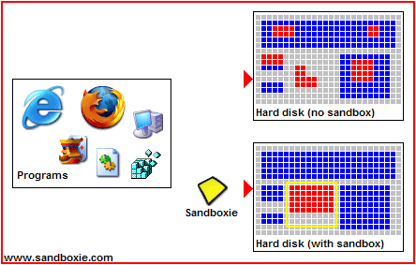
Sandboxie
Sandboxie creates chroot like file system sandbox which means it has same benefits and limits as chroot
http://www.sandboxie.com/
With sandboxie the exploit
needs to be able to break it
in order to infect the system
However browser can be
taken over in the sandbox
and thus attacker can have
access to your browsing

Slide 41
User Applications
Just like services end user applications contain security vulnerabilities
  So make sure users are running updated versions
  Disable all functionality that is not needed by users
Getting users to update by their own does not work
Thus you want to make sure that all applications that
work with external data are centrally deployed
Also you should consider less attacked alternatives
Foxit PDF reader instead of Adobe Acrobat
  Disable, javascript, flash, etc no matter what you use
Libre office instead of Microsoft Word

Slide 42
WWW browsers
Browsers and plugins are most common attack vector
  So disable all plugins that you don't need
    Java,JavaScript, ActiveX, Flash, etc
  Use click to play to control those plugins that you need
  If browser uses security zones, set all but trusted sites to high security zone
  Right now most systems are compromised with Java Applets
  so remove Java from browsers, no exceptions
In addition to 'automatic' threats there is also the user
  Clicking email attachments, executing downloaded files
  Many attacks rely on curiosity or social engineering

Slide 43
IRC and Instant Messaging
Much more than just exchanging text messages
Most protocols allow to exchange files
  Users downloading illegal content
  Users downloading content that contains viruses
And also messaging software has security holes
  Automatic downloading of content without asking from user
  Buffer overflows and other vulnerabilities that allow remote code execution

Slide 44
File Sharing Software
P2P and other file sharing software are a problem
Legal problems
  Users downloading illegal content
  Users sharing illegal content using company computers
Security problems
  Vulnerabilities in the software
  Users downloading content containing viruses
  Users accidentally offering their whole hard drive or network drives for download

Slide 45
Office Applications
Configure office software to block some exploits
  Install office file validation. It prevents some exploits
  Block ActiveX, flash and other embedded components
  Use sandboxing to isolate office apps, after all they need write access only to document directories
Document data fields may contain confidential info
    User names, computer names, bits of other files
    Editorial comments, deleted text, earlier versions
    Documents being sent out should be sanitized
    If no editing is needed convert docs to PDF

Slide 46
http://www.theregister.co.uk/content/4/35277.html
From The Register
A year ago, 10 Downing Street published a dossier on Iraq's security and intelligence organisations. It was cited by none other than Colin Powell in his address to the United Nations. Then a lecturer in politics at Cambridge University discovered that much of the 19-page document was copied from three different articles, one written by a graduate student.
How did he know? In the document there was a listing of the last 10 edits of the document, showing the names of the people who worked on the file. These logs are normally hidden and cannot be viewed directly in Word.

Slide 47
OS Hardening
Configuring the operating system so that it as resilient to attacks as possible
  Application access rights, privileged applications
  Application configurations
  User access rights
  Running services
  Firewall settings
  Log settings
There are several hardening instructions and programs available for different operating systems

Slide 48
Unix Hardening Guides
Ubuntu
  www.securenetwork.it/ricerca/whitepaper/download/Debian-Ubuntu_hardening_guide.pdf
OSX
  http://www.nsa.gov/ia/_files/factsheets/macosx_10_6_hardeningtips.pdf
Solaris
  www.certconf.org/presentations/2003/Tues/TM1.pdf

Slide 49
Windows Configuration Guides
NSA Windows hardening guide
  http://www.nsa.gov/snac/os/win2003/MSCG-001R-2003.PDF
FIRST best practices
  http://www.first.org/resources/guides/
Microsoft Security Guides
  Search for security guide in Microsoft download center

Slide 50
Windows UAC
Windows 7 provided a lot of security improvements
One of the important new benefits is the UAC User Account Control
  In addition of annoying user with modal dialogs, it provides automatic sandbox for applications that try to do dangerous things
Too bad that most users get so many questions that they automatically answer YES to every question
But if you create smart group policies, people will see the UAC dialog so rarely that they might pay attention
http://technet2.microsoft.com/WindowsVista/en/library/00d04415-2b2f-422c-b70e-b18ff918c2811033.mspx

Slide 51
Application Whitelisting
In corporate environment allowing all applications makes no sense
It might be a good idea to consider whitelisting applications and allowing only supported apps to run
This means that IT approves every application/software vendor whose applications are allowed
In Windows this can be done either with
  Software restriction policies
  Applocker code signing based control

Slide 52
Restriction Software Execution
Both Applocker and SRPs allow to control what is allowed to run
In strict mode only software explicitly allowed can run
  However this requires constant effort
Lighter but still secure way locks only places commonly used by malware
Users can install well behaving applications, but unusual code is prevented from running

Slide 53
Making Malware Uncomformtable
Allow only signed code to run
  Windows directory
  Anywhere but “Program files” and appdata
Prevent code from running
  Documents and settings
  Root of application data
  Root of program files
  C:\

Slide 54
Outsourced Whitelisting
Configuring and maintaining whitelist can be a big effort
Especially if user need to be allowed to install software
One solution for the problem is to use whitelist service
Whitelist service uses server based big database of known good applications
However there is no guarantee that the list is 100% clean
Also whitelists don't protect against document and other exploits that reside only in memory of compromised application

Slide 55
Memory Hardening
Microsoft EMET hardens application memory handling
With EMET code that triggers memory error is halted
Which means that it breaks exploits
It is possible to bypass EMET on some exploits
But only if attacker takes EMET into account
And on some exploits there is no way to circumvent EMET
However can also break applications, so make sure you first test with pilot workstation before rolling out

Slide 56
Firewalls From Inside Out
Each host must have a firewall protecting it
  Obvious use is of course filtering inbound traffic
But it is also important to filter outbound traffic
  Why allow workstation to make any connection types it doesn't need?
  Limit the traffic so that the hosts can send only the types of traffic it's applications need
  Proper filtering makes life difficult for network Worms :)
  Also any host that is sending traffic that is supposed to be filtered is rather suspicious...

Slide 57
Anti-Virus
There have been recent claims that Anti-Virus software are not effective, some even claim that they are BS
Those studies are bullshit
They test only scanner component, which is about 15% of total protection provided by modern AV suite
Modern AV are attack blockers and behavioral detection systems, scanner is just a fallback
However if you use only the scanner from AV suite, then it indeed is almost useless

Slide 58
Things To Require From AV
Web site blocking
Web traffic scanning
Exploit detection and blocking
Server based file reputation system
Behavioral monitoring and behavior detection
File scanning and heuristic detection
Whitelisting and notification about unknown executables

Slide 59
System Scanners
Tools that check security of the host
  Gives analysis of what would be visible for attacker that manages to log in as normal user
  Analyzes host configurations, applications, permissions and other standard checks
  Alerts if it find something that might help attacker in cracking the system from inside
  Useful tool for checking the 'second line of defense' for the case where attacker has access to normal login on the system (for example employee, or someone who found the users password)

Slide 60
OSSEC
Open source system scanner from Trend Micro
Monitors system for signs of intrusion and alerts
  File system changes
  Changes in critical binaries
  Changes in launch points
  Changes in critical system settings
  Changes in security settings
  Whatever you want to add to config files
Bit light, but will detect most common signs of infection

Slide 61
CORE Impact
Network based penetration testing tool and system scanner
Performs penetration testing on target hosts using specially crafted version of exploits that don't harm system but test whether system can be broken into
Gives full list of known vulnerabilities and recommendations for fixes
In a sense commercial version of Nessus

Slide 62
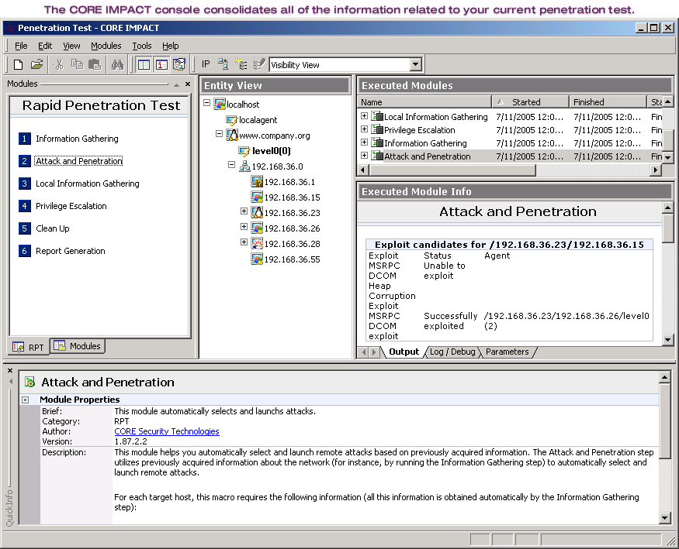
CORE Impact

Slide 63
Documentation
Document the system after it has been installed
  System configuration
  Installed applications
  Installed services
  Services that are visible outside (WWW,SSH,etc)
  Modifications done after system install
  All security events that have occurred on the system
  System security evaluation

Slide 64
Managing The System
Just installing the system is not enough
  New security holes are discovered all the time
  Even most secure installation may become vulnerable with time, as new holes are found
  Unmanaged system is ideal target for attacker as successful break in may be never found
  A test server forgotten at the corner of some lab is very typical initial target for attack

Slide 65
Keep The System Up To Date
There is no permanently secure system
  New vulnerabilities are discovered even in old software versions
Keep track of the security developments on your system
  Vendor security and update announcements
  Information security mailing lists
When a hole is found, plug it immediately
  And install the patch as soon as it comes

Slide 66
Apply Updates Only On Trusted Net
Most update protocols don't do proper checks
Thus someone who has MITM control can compromise updates that you are downloading
And thus you end up downloading trojanized update
The best defense is to make sure that workstations can download updates only over VPN connection
http://www.infobytesec.com/down/isr-evilgrade-Readme.txt

Slide 67
Installing New Applications
Many times administrators are careless when installing new applications or services
  Always when adding something new same care should be taken as when the system was installed
Find out what you are installing to the system
  What is the reliability and security level of the application?
  What modifications it makes into the system
Document the installation
  What was added and when, what was modified

Slide 68
Services,Vulnerabilities, Exploits
All programs contain errors
  Vulnerability is an error that allows attacker to affect the operation (take over) of a service or the system
  To exploit a vulnerability is to use the error for attack
When a vulnerability is found news spread fast
  Usually application vendor is informed first
  After a short delay the information is published
  After the vendor is informed it produces a new version or patch that fixes the problem
  Sometimes getting a fix may take a while

Slide 69
Information Security Mailing Lists
www.cert.com, www.cert.fi
  Computer Emergency Response Team
www.securityfocus.com
  Bugtraq, Linux-secnews, MS-secnews
www.ntbugtraq.com
  NTBugtraq
Full-disclosure
  https://lists.grok.org.uk/mailman/listinfo/full-disclosure
Vendor specific lists

Slide 70
Enterprise Configuration Management
Keeping couple computers up to date is easy
  But when you have network of several hundred systems, things get a lot more difficult
Maintaining systems by hand is not cost effective
  Which means that quite often job is half done
Good answer to problem is to use Enterprise Configuration Management system
  ECM gathers database of system configurations
  And matches this against known vulnerabilities and misconfigurations. Kind of enterprise level system scanner

Slide 71
Configuresoft ECM
ECM collects security and configuration data from all computers in corporate infrastructure
From this data the administration can keep track what software is in use and make sure that all patches are installed
ECM provides
  Vulnerability discovery and notification
  Patch assessment and delivery
  System configuration management
  Configuration enforcement

Slide 72
Users And Systems
A real system cannot be fully secured from users
  A system that is totally safe is also unusable
However do everything that is possible
  Make sure user has only the rights they need
  Provide user with applications they need
  Choose safe applications for tasks, or at least avoid the most risky ones
  Shield users from each others
  Most users aren't stupid, they just need training!

Slide 73
User Accounts And Groups
When user is created a new account is added
  Each user must have his own account
  Each user should have home directory to store own files
  No one else should have access to users home
Use groups to allow access to shared resources
  Groups should be formed and tasks and needs
  All shared directories should be allowed only those groups who need it
  When a user who is no longer in some team/task he should be removed from relevant groups

Slide 74
Managing User Accounts
Close unused default accounts
Remove default passwords
  For example oracle sys and system accounts
Make sure there are no open accounts
  Open account is one that does not have password
If possible restrict user accounts
  Many shells allow restricting user to home directory
Disable unused accounts
  Or make all accounts expire automatically

Slide 75
Rules For Good Passwords
  The password must be at least 14 characters long.
  The password must contain at least
    One lower case and upper case character [a-zA-Z]
    Three numeric characters [0-9]
  The password must not:
    contain spaces
    contain your login ID or parts of login ID
    The first 3 characters cannot be the same.
    Must not be similar to your previous password
  Good choice is a phrase that is easy to remember
    Rav1ntolacosm0ksenKall1smeNu

Slide 76
The Problem With Passwords
Passwords that are too short or easily guessable can be broken in quite short time
  But strong passwords are hard to remember
  Especially if one person has to remember unique passwords to 15 different systems...
This causes people to
  Write down passwords
  Choose weak passwords
  Use same password for several systems

Slide 77
Use Password Managers
Password manager provides secure password storage
Basically it is encrypted container secured with PW
Thus user has to remember only 1 password
  Also attacker has to be able to obtain the PW DB
The password is used in key derivation function
  Which loops x rounds and produces actual key
Some password managers like F-Secure key offer automatic sync across devices

Slide 78
Alternatives To Password Authentication
One time passwords
  User has a list of passwords, each is used only once
Certificate based systems
  User has single certificate protected by password
Token based systems
  User has some physical token that is used for authentication
  Instead of entering password the user inserts the token to the system which then does authentication
    Smart cards, USB dongles, magnetic cards, security buttons, biometric tokens (fingerprints, retina, face)

Slide 79
Two Factor Token Authentication
Based on two authentication components
  User has some authentication token and password
  The token first asks for password before it can be used to authentication
    Usually short PIN code (4-8 numbers)
  After user authentication token authenticates itself to the system
  Thus users needs something to have, token
  And something to know, password to activate the token

Slide 80


RSA SecurID Token Based Authentication System
Provides two factor authentication with two styles
  Challenge response token protocol
    User has special 'calculator' and PIN code to use it
    When user logs in system gives challenge value, and user calculates response by entering the challenge and his PIN code
  Stand alone token protocol
    User has some token that is used for authentication
    When used for authentication the token first asks for PIN code before it authenticates itself to the system
http://www.rsasecurity.com/products/securid/

Slide 81
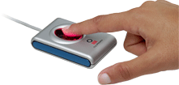
U.are.U Fingerprint Authentication
Biometric authentication system based on identification of fingerprints
  Comes with special reader connected to workstation
  When user logs in he has to put his finger to reader
Fingerprint authentication is secure because there is nothing to tell to anyone or to give away
However fingerprints can be copied and faked
  Thus it is important to use two factor authentication in critical systems!
Http://www.digitalpersona.com/

Slide 82
Fast Access Facial Recognition
Fast access is facial recognition based login control
Show the system your face and it let's you in
Bad quality facial recognition can be fooled by a picture
So use only software that supports liveliness check
For corporate use you want to use a second factor
  Icon selection
  Pattern check
  Old fashioned password

Slide 83
User Applications And Privileges
User programs run under it's owners permissions
  Program can do everything that user is allowed to
    If user access is properly configured, only users data is in danger
Some programs need privileges that user doesn't have
  This is usually solved by giving the application set-uid privileges, which means that application runs under file owner permissions. These are privileged applications
  The problem is that if there is a hole in privileged applications, attacker gains file owner permissions
  Thus one should minimize number of privileged applications, and avoid writing privileged code!

Slide 84
Privileges Example: PING
On most systems ping is owned by root but executable by all and has set-uid privileges
  Unix: -rwsr-xr-x 1 root root 31292 2002-09-10 23:29 /bin/ping
  Windows: ..\system32\ping.exe is owned by administrator
  Thus is someone manages to exploit a vulnerability in ping, he will get the file owner (root permissions).
  Ping command is relatively safe, as the command line parameters are simple. But what about application that takes undefined number and length of parameters? What if the input buffer used by application is too small?
  Any privileged application is potential target for attacker who has user access to system.

Slide 85
User Training
Train your your people to
  Detect and block social engineering
  Know where to store data so that it won't be lost
  How to handle confidential material
  To be wary with personal information and Net
  Not to use company access on anything questionable
  To be suspicious of Email
  To notice Web page tricks and attacks
  Not to run just about anything found from the Net

Slide 86
Backing Up The System
To make proper backups you need to know what you are doing!
  Make a backup process that describes
    What is backed up and who does it!
    How often
    Where backups are stored
    How often full backup is made for permanent storage
    How often backup medias are replaced, tapes don't last forever you know
    How often the backups are verified!
    Do you need backup hardware!

Slide 87
Recovering Backups
In addition to having and following backup process. Also have recovery process
  Who does the recovery
  How to verify that backups are not corrupted
  How often to practice system recovery
  What is the expected time to do the recovery
In addition of making the process, practice!
  Try to restore a system from backup
  Take time how long recovery takes
  Problems recovering backups? Update process!

Slide 88
Monitoring The System
Just having a secure system is not enough if you don't know whats going on in the system!
Monitor the system to
  Detect intrusion into the system
  Catch misuse of the system by legitimate users
  Find viruses worms and other automatic malware
  Detect unauthorized applications (games, P2P,etc)
  Detect illegal content stored by users
    Pirated software, Movies, child porn, etc
  Consult lawyer what you are allowed to monitor...

Slide 89
Know Whats Going On
Almost all services and system processes keep logs
  Logs are invaluable in figuring out whats happened, be it software problem or successful attack
Logs don't help if the attacker modifies or erases them
  Store the logs on write once media
  Duplicate logs on several machines
  Store duplicate logs on different partition
Note that some logs contain personal information
  And thus are under personal information law

Slide 90
Important Logs In Unix Systems
syslog
  Events from programs and subsystems
    Network connections, firewall messages, logins, etc
authlog
  Messages from authentication services
    Failed password for jargon from 10.1.1.2 port 33352
Sulog
  Executions of 'su' command to get superuser rights
Process accounting log
User shell command history
Special logs by services, for example apache log

Slide 91
Protecting Logs In Unix
Configure what you want to log by /etc/syslog.conf
Set up remote logging to some other computer from syslog
Make a custom script to make backups of the logs
  Preferably on write only media
Use custom software to periodically to add digital signatures to log files
  Makes logs much harder to tamper with
Use your imagination,the harder to guess the better

Slide 92
Important Logs In Windows
System log
  Device driver activities, hardware failures, starting/stopping services and duplicate IP addresses
Application log
  Messages by non-system applications
Security log
  Logins/logouts, changes in user privileges, changes in file system permissions, file and directory access

Slide 93
Protecting Logs In Windows
Configure proper logging so that important events are stored
Configure remote logging
  http://ntsyslog.sourceforge.net/
Make a custom script to make backups of the logs
  Preferably on write only media

Slide 94
Integrity Checkers
Integrity checkers go through system critical files and calculate checksum for each file
The idea is to detect any changes in the system and inform administrator about them
Critical things in integrity checkers
  Where the integrity database is stored
  Can the system be trusted to run the checker
  Where the report about the results go
  Can attacker prevent the checker from running

Slide 95
AIDE
AIDE is an free Open source integrity checker for UNIX (f.ex comes with Debian and SUSE)
When AIDE is installed with creates a database of important system directories.
When run it reports all changes in email
  Modified files
  Added files
  Removed files
  Changed timestamps
http://aide.sourceforge.net/

Slide 96
Sample AIDE output
This is an automated report generated by the Advanced Intrusion Detection
Environment on gateway.drivermuseum.com at 06:25:02 on 02/05/03.
Output of the daily AIDE run:
Output is 1185 lines, truncated to 1000.
Dead symlink detected at /usr/lib/libartsdsp_st.so
Dead symlink detected at /usr/lib/libartsdsp_st.so
AIDE found differences between database and filesystem!!
Start timestamp: 2003-02-05 06:25:03
Summary:
Total number of files=17898,added files=26,removed files=9,changed files=282
Added files:
added:/usr/bin/ncftpget
added:/usr/bin/ncftpput
Removed files:
removed:/usr/bin/firestarter
removed:/usr/doc/firestarter
removed:/usr/lib/menu/firestarter
Changed files:
changed:/lib/modules/2.4.18-686/modules.dep
changed:/lib/modules/2.4.18-686/modules.generic_string

Slide 97
Tripwire
Tripwire is integrity checker tool for Windows systems
  Also Open source Linux version is available
More information
  http://www.tripwire.com/

Slide 98
System Monitors
Provide information how your system is doing
  Temperature, voltages, AC current, free disk space
  Hardware status (HDD S.M.A.R.T, RAID status)
  Current and average system load
The monitors have two purposes
  Warn administrator before the system breaks
  If possible react automatically to problem
    Shutdown the system, free up space, drop non-critical actions, warn users, what ever is needed

Slide 99
Log Watchers
Logs watchers are tools that monitor specified log files for suspicious activity
Swatch (swatch.sourceforge.net/)
  Watches the log files for user specified events
  Invalid log ins, application panic messages, system temperature
  Executes specified command at event
  Requires administrator to know what to look for

Slide 100
Sample Swatch Config
# Swatch configuration file for constant monitoring
# Bad login attempts
watchfor /INVALID|REPEATED|INCOMPLETE/
echo
bell 3
exec "/usr/local/sbin/badloginfinger $0"
# Machine room temperature
watchfor /WizMON/
echo inverse
bell
# System crashes and halts
watchfor /(panic|halt)/
echo
mail
exec "call_pager 3667615 0911"

Slide 101
Conclusion
This time we covered information security from single system point of view
  Integrity
  Availability
  Management
  Recovery
  Security tools

Slide 102
References
Maximum Linux Security
Rootkits
  http://www.theorygroup.com/Theory/rootkits.html
Disaster Recovery Plan Strategies and Processes
  http://www.sans.org/rr/recovery/processes.php

Slide 103
References
Maximum security, fourth edition
  Anonymous, SAMS publishing
  ISBN 0-672-32459-8
Practical UNIX & Internet security
  O'Reilly
  ISBN 0-596-00323-4

